Slide 1
MATH + GRAPHICS
1 / 10
3D
3D Camera
Transformations
2D
CAMERA
Mathematical Visualization of 3D → 2D Coordinate Transformations and Projection Using Matrix Operations
COURSE
Mathematical Foundation for AI & Data Science
TEAM
Karthick M (PES2UG25CS250) · Sai Arjun (PES2UG25CS244)
Jayanth K.P (PES2UG25CS231) · Jeevan N (PES2UG25CS232)
PES University, Bengaluru · October 2026

Slide 2
MOTIVATION
2 / 10
Problem Statement
3D Object
Matrix Transformations
2D Image
3D World
Camera
Projection
2D Image
How can a 3D point be transformed into its corresponding 2D image point?
How do we bridge this gap?
A computer stores objects in 3D space — but a screen is a 2D surface.

Slide 3
FOUNDATIONS
3 / 10
3D Coordinate System
3D point → homogeneous form → unified matrix transformations
3D Coordinate System
A point is represented by three coordinates: x, y, and z
Homogeneous coordinates:
Why a 4th coordinate?
z
x
Translation cannot be expressed as pure matrix multiplication in 3D. Adding w = 1 allows all affine transformations — including translation — to be unified as matrix products.
P =
y
x
z
1
Standard representation:
P = (x, y, z)
P = (x, y, z)
y
Representing a point in 3D space and extending it to homogeneous coordinates.

Slide 4
TRANSFORMATIONS
4 / 10
Transforming Points with Matrices
P' = M₃ · M₂ · M₁ · P Multiple transforms combine via matrix multiplication
Translation
Scaling
T =
1
0
0
t_{x}
S =
s_{x}
0
0
0
0
1
0
t_{y}
0
s_{y}
0
0
0
0
1
t_{z}
0
0
s_{z}
0
0
0
0
1
0
0
0
1
Matrix multiplication applies geometric transformations to 3D points in homogeneous coordinates.

Slide 5
CAMERA
5 / 10
Camera Transformation
World Space
M_view
Camera Space
World Coordinates
View Transformation
Camera Coordinates
P_camera = M_view · P_world
The view transformation converts world coordinates into camera space.

Slide 6
PROJECTION
6 / 10
Projection: Camera to Screen
PERSPECTIVE
ORTHOGRAPHIC
Division by z creates depth-dependent scaling.
Used in engineering and architectural views.
Objects farther from the camera appear smaller.
Depth does not change the apparent size.
x' = f · (x/z)
x' = x
y' = f · (y/z)
y' = y

Slide 7
PIPELINE
7 / 10
The Complete Mathematical Pipeline
3D Point P₃D
World coordinate
Matrix Chain:
World Transform M_world
Scale, Rotate, Translate
P_projection
View Transform M_view
Camera coordinate system
· M_view
Camera Coordinates
Scene from camera perspective
· M_world
Projection P_projection
Perspective or orthographic
· P₃D
= P₂D
2D Coordinates P₂D
Screen pixel mapping
P₂D = P_projection · M_view · M_world · P₃D

Slide 8
RESULTS
8 / 10
Mathematical Result: 3D → 2D Projection
3D Pyramid
2D Projection
Projected Coordinates
x'
y'
-15.260
6.134
-6.163
-9.393
Pipeline
-16.790
-13.337
-19.568
-7.380
-10.157
-4.485
Applying the complete pipeline to a 3D scene yields 2D screen coordinates:
These screen coordinates map each vertex of the 3D pyramid to its position on the 2D display surface.

Slide 9
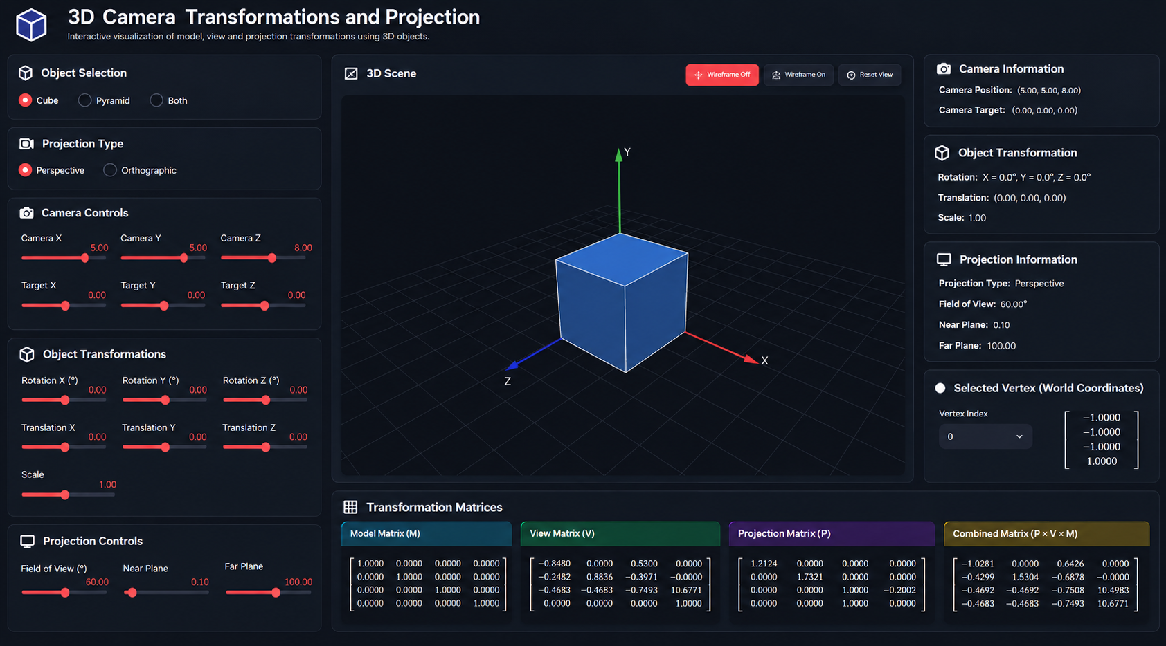
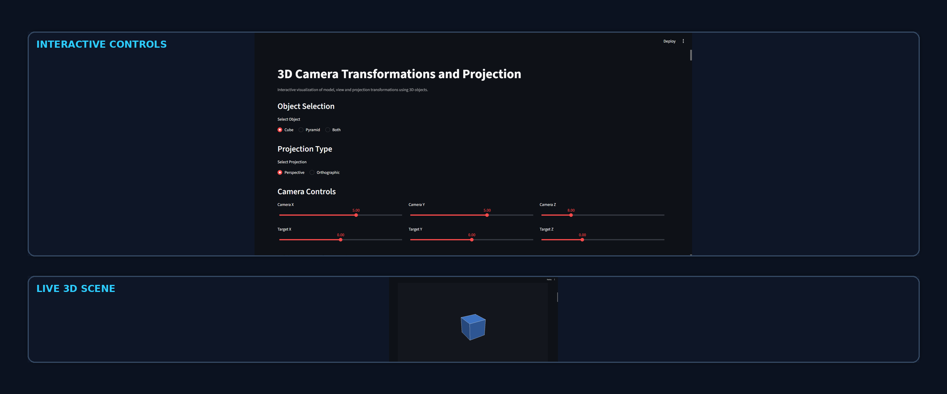
IMPLEMENTATION
9 / 10
Interactive Prototype
Object • Camera • Projection • Matrices • Vertex Pipeline

Slide 10
CONCLUSION
10 / 10
Conclusion & Future Scope
3D Point × M_world × M_view × P_proj = Screen
This Project Connected
Future Extensions
Coordinate Frame Algebra
OpenGL-based rendering
Perspective Projection
Additional projection models
Cross Products
Animation & motion paths
Camera Transformations
Complex 3D objects & scenes
Homogeneous Coordinates
Real-time 3D visualization
3D Rotations
Interactive camera controls
Matrix Operations
Vectors & Direction
3D Geometry + Linear Algebra → 2D Visualization

